Slide 1
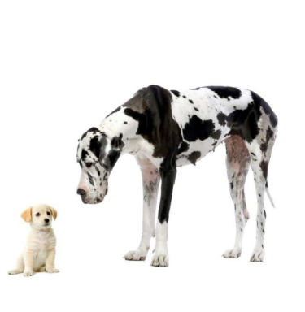
Opposites

Slide 2
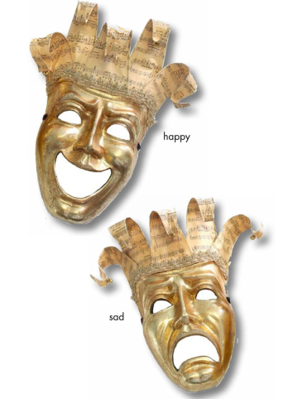

Slide 3
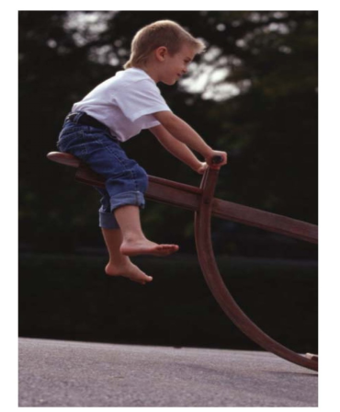
This is up.

Slide 4

This is down.

Slide 5
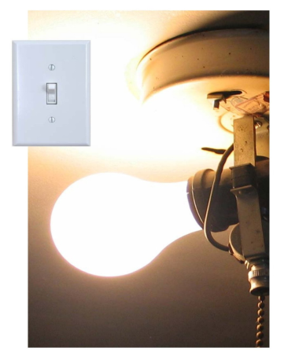
This is on.

Slide 6
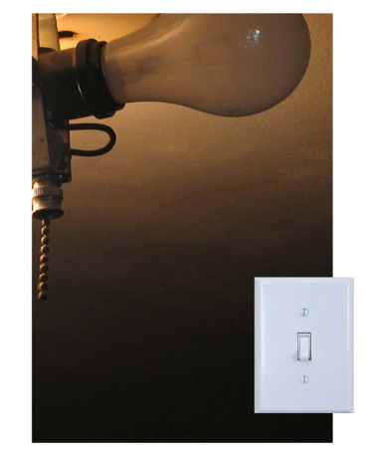
This is off.

Slide 7

This is open.

Slide 8

This is closed.

Slide 9
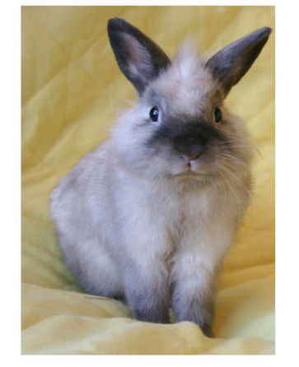
This is fast.

Slide 10
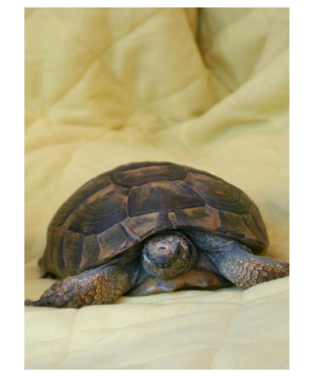
This is slow.

Slide 11

This is _____________________ .
This is _____________________ .

Slide 12
Happy and sad
Up
Slow
Down
On
Off
Open
This is…
Closed
Fast
Click on the colored stars to start getting to know them!

Slide 13
RETURN

Slide 14
RETURN
This is up.

Slide 15
RETURN
This is down.

Slide 16
RETURN
This is on

Slide 17
RETURN
This is off.

Slide 18
RETURN
This is open.

Slide 19
RETURN
This is closed.

Slide 20
RETURN
This is fast.

Slide 21
RETURN
This is slow.

Slide 22
RETURN
This is _____________________ .
This is _____________________ .

